Slide 1

Igniting the Spark,
For the Love of Big Data
ThoughtWorks Gurgaon
By
Achal Aggarwal &
Syed Atif Akhtar

Slide 2

Notes:
-What is big data
-Problem back then
-

Slide 3
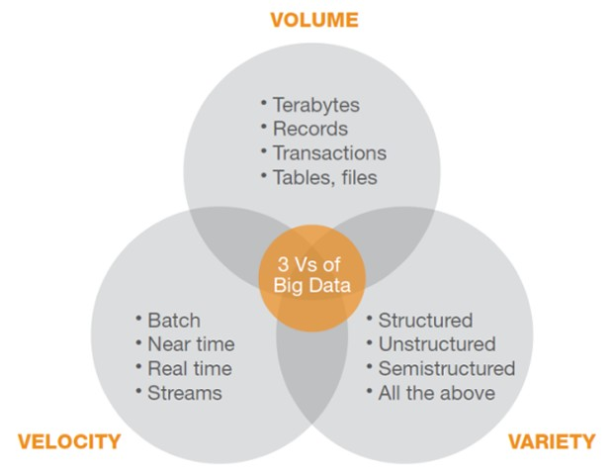
The 3 V’s revisited

Slide 4
Open source framework
Used for storage and large scale processing of data-sets on clusters of commodity hardware
Mainly consists of the following two modules:
- HDFS (Distributed Storage)
- MapReduce (Analysis/Processing)
Hadoop
Consumer
Venue
Artist

Slide 5
Limitations with Hadoop MR
Only Batch Processing.
Hadoop MR API is not functional.
MR has a bloated computation model.
Has no awareness of surrounding MR pipelines, which can be used for optimization.
Iterative algorithms are difficult to implement.

Slide 6
Spark to the rescue!
Mappers do not write to file system (by default).
Uses Akka for data communication between nodes.
Lazy Computation.
Functional syntax.
Better RDD (Resilient Distributed Dataset) API.
Extension of Spark Streaming for (near) Real-time processing.

Slide 7
About Spark
Apache Spark™ is a fast and general engine for large-scale data processing.
-Speed
Run programs up to 100x faster than Hadoop MapReduce in memory, or 10x faster on disk.
Spark has an advanced DAG execution engine that supports cyclic data flow and in-memory computing.
-Ease of Use
Write applications quickly in Java, Scala, Python, R.
Spark offers over 80 high-level operators that make it easy to build parallel apps. And you can use it interactively from the Scala, Python and R shells.

Slide 8
About Spark (Cont...)
-Generality
Combine SQL, streaming, and complex analytics.
Spark powers a stack of libraries including SQL and DataFrames, MLlib for machine learning, GraphX, and Spark Streaming. You can combine these libraries seamlessly in the same application.
-Runs Everywhere
Spark runs on Hadoop, Mesos, standalone, or in the cloud. It can access diverse data sources including HDFS, Cassandra, HBase, and S3.
You can run Spark using its standalone cluster mode, on EC2, on Hadoop YARN, or on Apache Mesos. Access data in HDFS, Cassandra, HBase, Hive, Tachyon, and any Hadoop data source.

Slide 9
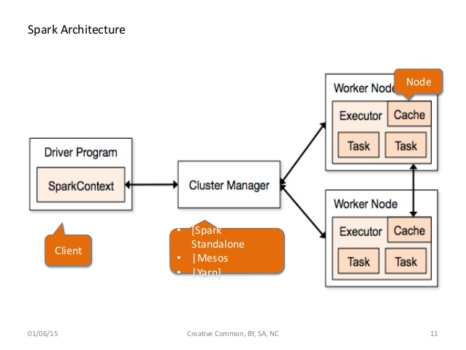
Spark Architecture

Slide 10
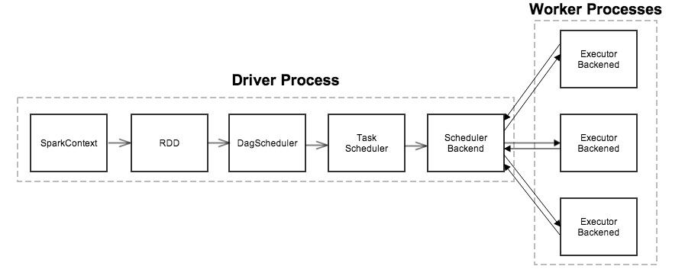
Dig Deeper..

Slide 11
Resilient Distributed Datasets (RDDs)
RDDs are huge collections of records with following properties –
Immutable
Partitioned
Fault tolerant
Created by coarse grained operations
Lazily evaluated
Can be persisted
Notes:
The Resilient Distributed Dataset is a concept at the heart of Spark. It is designed to support in-memory data storage, distributed across a cluster in a manner that is demonstrably both fault-tolerant and efficient. Fault-tolerance is achieved, in part, by tracking the lineage of transformations applied to coarse-grained sets of data. Efficiency is achieved through parallelization of processing across multiple nodes in the cluster, and minimization of data replication between those nodes. Once data is loaded into an RDD, two basic types of operation can be carried out:

Slide 12
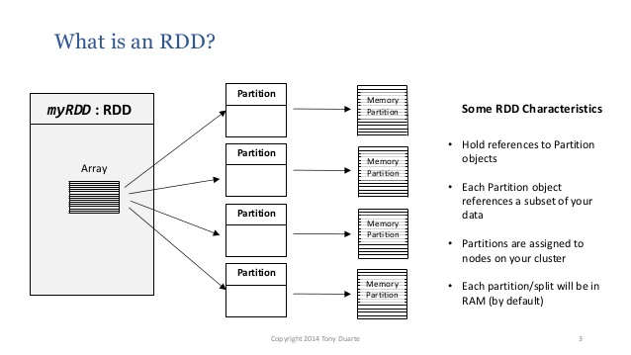
What is an RDD?
Notes:
The Resilient Distributed Dataset is a concept at the heart of Spark. It is designed to support in-memory data storage, distributed across a cluster in a manner that is demonstrably both fault-tolerant and efficient. Fault-tolerance is achieved, in part, by tracking the lineage of transformations applied to coarse-grained sets of data. Efficiency is achieved through parallelization of processing across multiple nodes in the cluster, and minimization of data replication between those nodes. Once data is loaded into an RDD, two basic types of operation can be carried out:

Slide 13
Partitioning
The data within an RDD is split into several partitions.
Properties of partitions:
Partitions never span multiple machines, i.e., tuples in the same partition are guaranteed to be on the same machine.
Each machine in the cluster contains one or more partitions.
The number of partitions to use is configurable. By default, it equals the total number of cores on all executor nodes.
Two kinds of partitioning available in Spark:
Hash partitioning
Range partitioning
Notes:
The Resilient Distributed Dataset is a concept at the heart of Spark. It is designed to support in-memory data storage, distributed across a cluster in a manner that is demonstrably both fault-tolerant and efficient. Fault-tolerance is achieved, in part, by tracking the lineage of transformations applied to coarse-grained sets of data. Efficiency is achieved through parallelization of processing across multiple nodes in the cluster, and minimization of data replication between those nodes. Once data is loaded into an RDD, two basic types of operation can be carried out:

Slide 14
Fault Tolerance (Lineage)
RDD keeps track of all the stages that contributed to that RDD
If there is any data loss for the RDD,only that particular RDD is recomputed from scratch and not all
Notes:
The Resilient Distributed Dataset is a concept at the heart of Spark. It is designed to support in-memory data storage, distributed across a cluster in a manner that is demonstrably both fault-tolerant and efficient. Fault-tolerance is achieved, in part, by tracking the lineage of transformations applied to coarse-grained sets of data. Efficiency is achieved through parallelization of processing across multiple nodes in the cluster, and minimization of data replication between those nodes. Once data is loaded into an RDD, two basic types of operation can be carried out:

Slide 15
Lazy Evaluation
Spark RDD’s are lazy evaluated ie no actual operation is performed on an RDD till any action that requires the output is called ie save to disk or a collect()
Notes:
The Resilient Distributed Dataset is a concept at the heart of Spark. It is designed to support in-memory data storage, distributed across a cluster in a manner that is demonstrably both fault-tolerant and efficient. Fault-tolerance is achieved, in part, by tracking the lineage of transformations applied to coarse-grained sets of data. Efficiency is achieved through parallelization of processing across multiple nodes in the cluster, and minimization of data replication between those nodes. Once data is loaded into an RDD, two basic types of operation can be carried out:

Slide 16
Persistence
Intermediate output from an RDD can be persisted on the worker nodes
Wise thing to do in cases where the RDDs need to be reused again
RDD2
RDD1
RDD3
Notes:
The Resilient Distributed Dataset is a concept at the heart of Spark. It is designed to support in-memory data storage, distributed across a cluster in a manner that is demonstrably both fault-tolerant and efficient. Fault-tolerance is achieved, in part, by tracking the lineage of transformations applied to coarse-grained sets of data. Efficiency is achieved through parallelization of processing across multiple nodes in the cluster, and minimization of data replication between those nodes. Once data is loaded into an RDD, two basic types of operation can be carried out:

Slide 17
Shared Variables
Accumulators - Write only on executor,read only on driver
Broadcast Variables - Write on driver,Read only on executors
Notes:
The Resilient Distributed Dataset is a concept at the heart of Spark. It is designed to support in-memory data storage, distributed across a cluster in a manner that is demonstrably both fault-tolerant and efficient. Fault-tolerance is achieved, in part, by tracking the lineage of transformations applied to coarse-grained sets of data. Efficiency is achieved through parallelization of processing across multiple nodes in the cluster, and minimization of data replication between those nodes. Once data is loaded into an RDD, two basic types of operation can be carried out:

Slide 18
Pair RDDs
An RDD of a pair/tuple (k,v)
More set of operations that can be performed
Important for defining joins
Notes:
The Resilient Distributed Dataset is a concept at the heart of Spark. It is designed to support in-memory data storage, distributed across a cluster in a manner that is demonstrably both fault-tolerant and efficient. Fault-tolerance is achieved, in part, by tracking the lineage of transformations applied to coarse-grained sets of data. Efficiency is achieved through parallelization of processing across multiple nodes in the cluster, and minimization of data replication between those nodes. Once data is loaded into an RDD, two basic types of operation can be carried out:

Slide 19
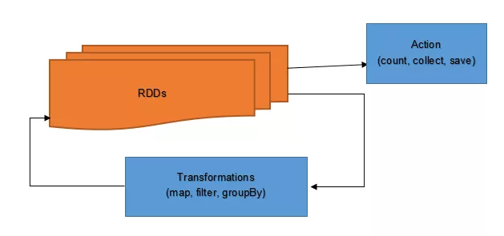
Types of Operations
Transformation - created new RDD by changing the original
Actions - measure but do not change the original data
Notes:
The Resilient Distributed Dataset is a concept at the heart of Spark. It is designed to support in-memory data storage, distributed across a cluster in a manner that is demonstrably both fault-tolerant and efficient. Fault-tolerance is achieved, in part, by tracking the lineage of transformations applied to coarse-grained sets of data. Efficiency is achieved through parallelization of processing across multiple nodes in the cluster, and minimization of data replication between those nodes. Once data is loaded into an RDD, two basic types of operation can be carried out:

Slide 20
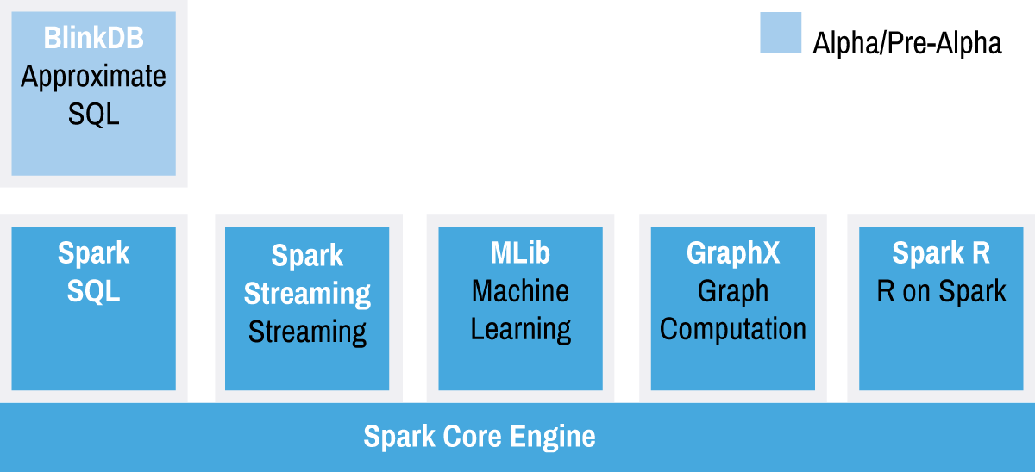
The Spark Stack
https://www.mapr.com/ebooks/spark/03-apache-spark-architecture-overview.html
Notes:
he Spark project stack currently is comprised of Spark Core and four libraries that are optimized to address the requirements of four different use cases. Individual applications will typically require Spark Core and at least one of these libraries. Spark's flexibility and power become most apparent in applications that require the combination of two or more of these libraries on top of Spark Core.

Slide 21
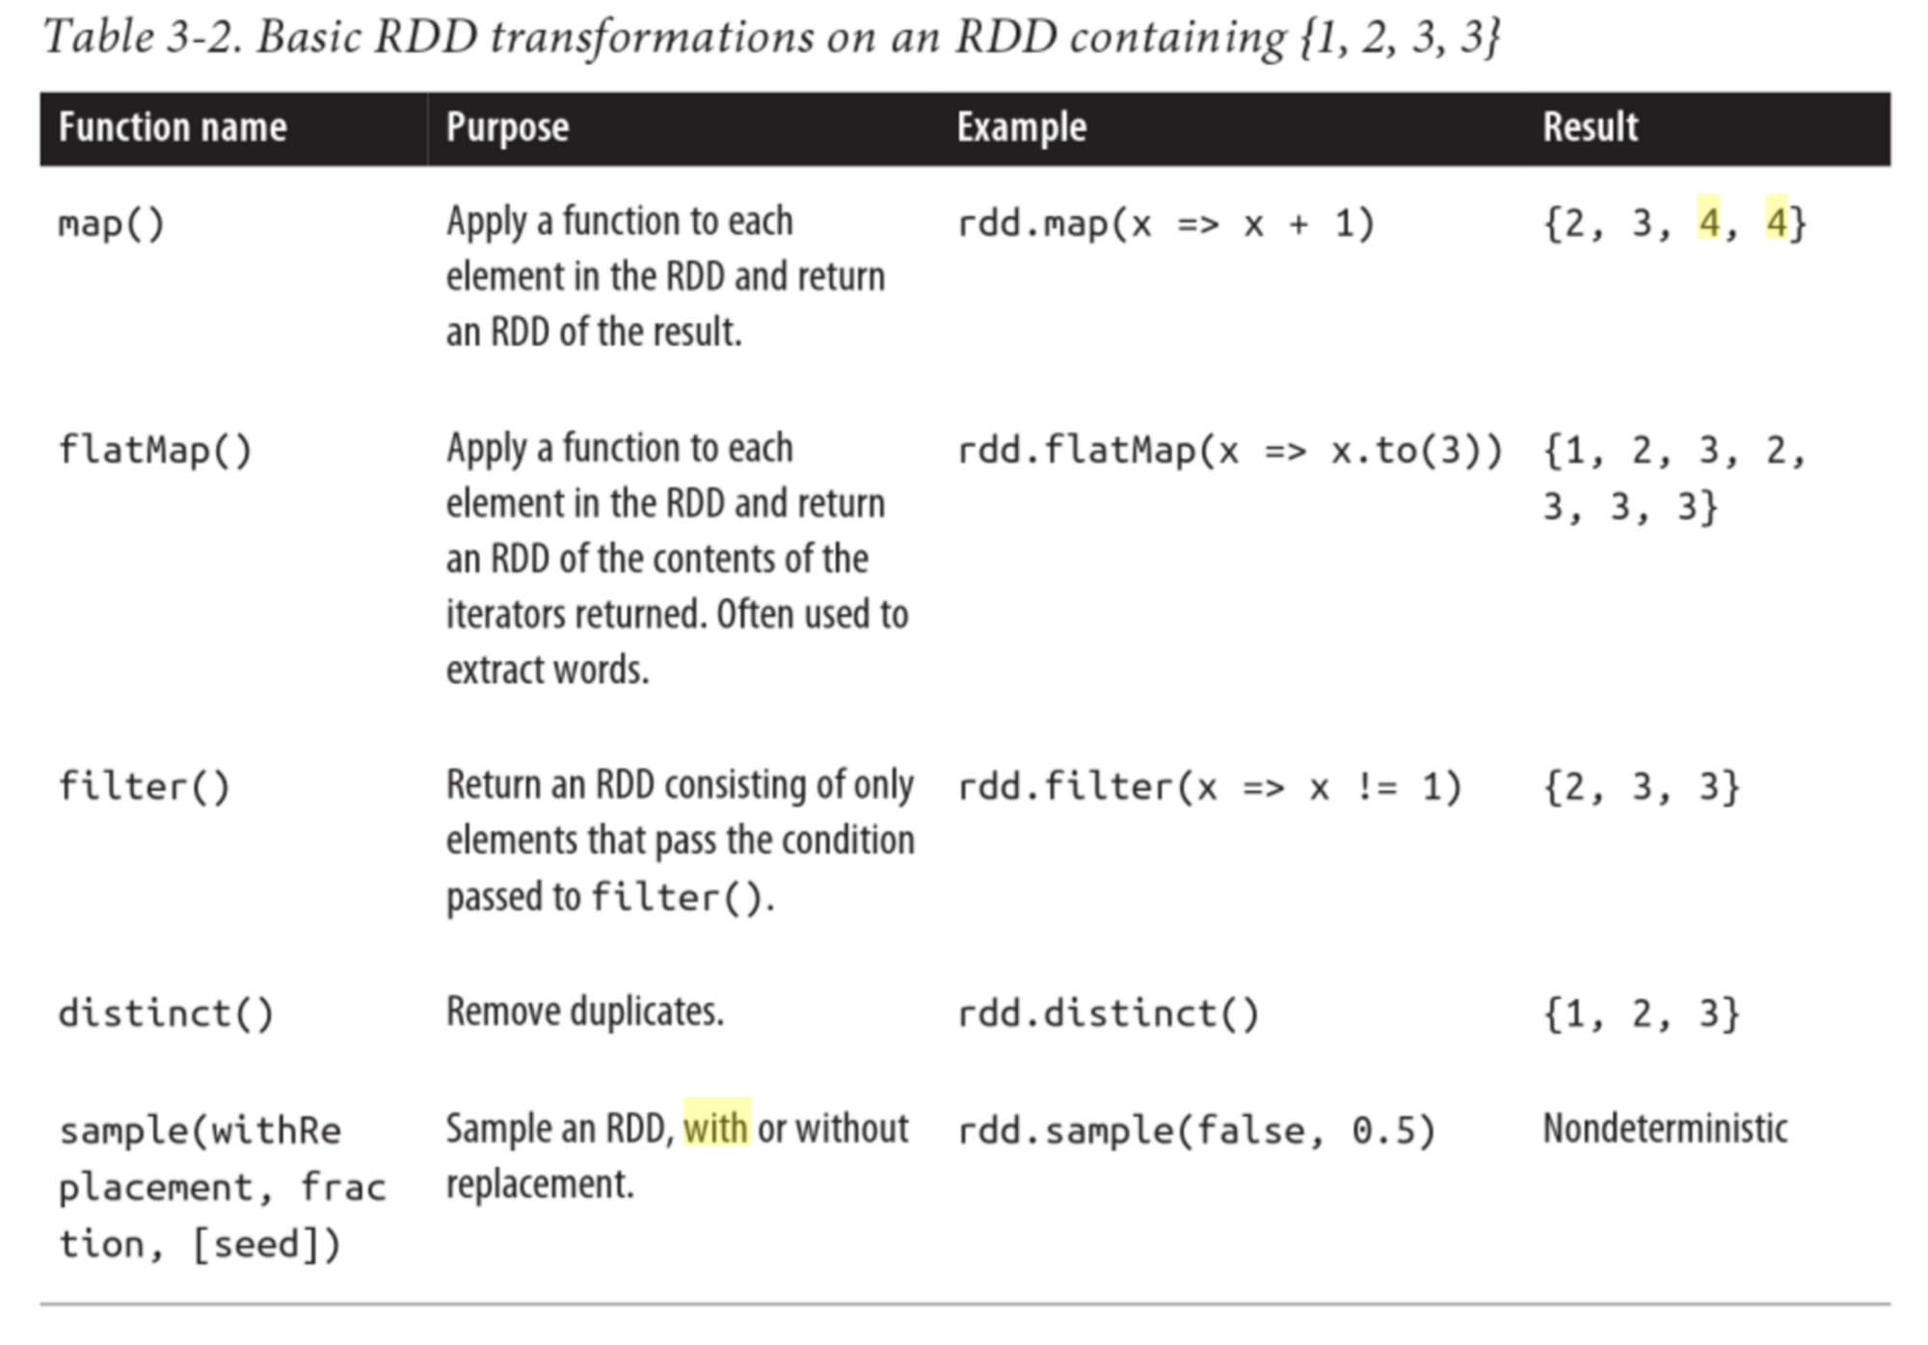
Spark Core

Slide 22
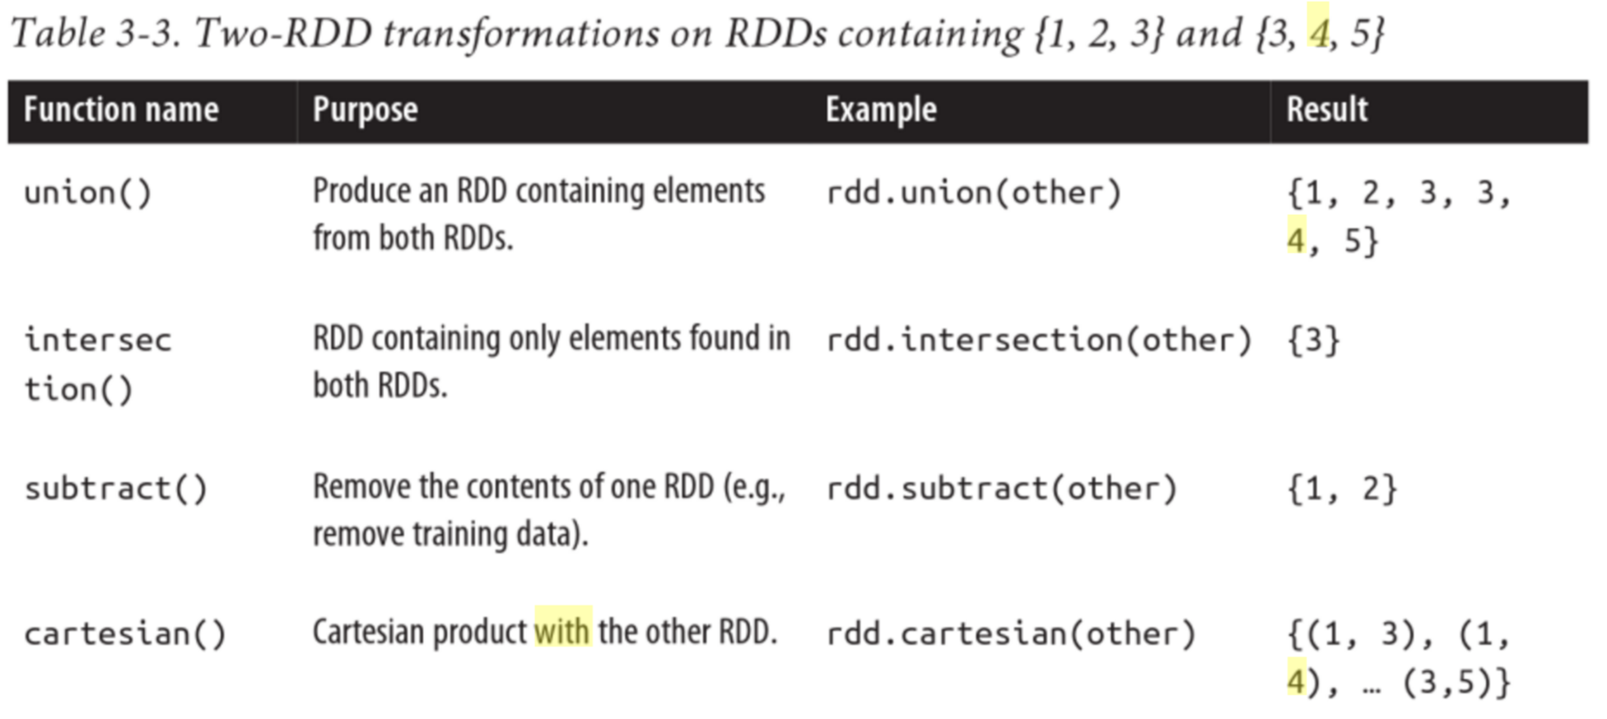
Spark Core (Cont...)

Slide 23
Spark Core - Example Word Count
Notes:
The Resilient Distributed Dataset is a concept at the heart of Spark. It is designed to support in-memory data storage, distributed across a cluster in a manner that is demonstrably both fault-tolerant and efficient. Fault-tolerance is achieved, in part, by tracking the lineage of transformations applied to coarse-grained sets of data. Efficiency is achieved through parallelization of processing across multiple nodes in the cluster, and minimization of data replication between those nodes. Once data is loaded into an RDD, two basic types of operation can be carried out:

Slide 24
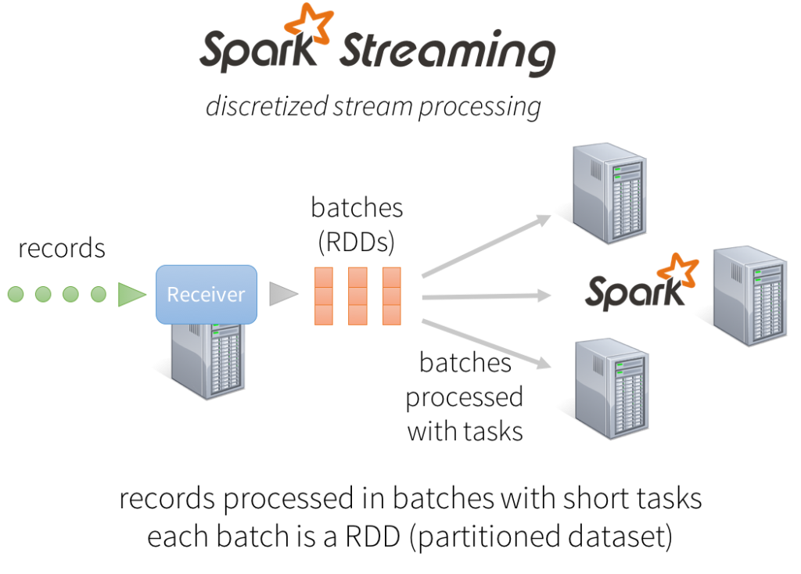
Spark Streaming - Discretized stream processing

Slide 25
Spark SQL
Data Frame: Can act as distributed SQL query engine.
Data Sources: Computation over structured data stored in a wide variety of formats, including Parquet, JSON, and Apache Avro library.
JDBC Server: To connect to the structured data stored in relational database tables and perform big data analytics using the traditional BI tools.
Notes:
http://www.infoq.com/articles/apache-spark-sql

Slide 26
Spark Streaming & SQL - Example

Slide 27
Thank You!
Questions?

